Slide 1
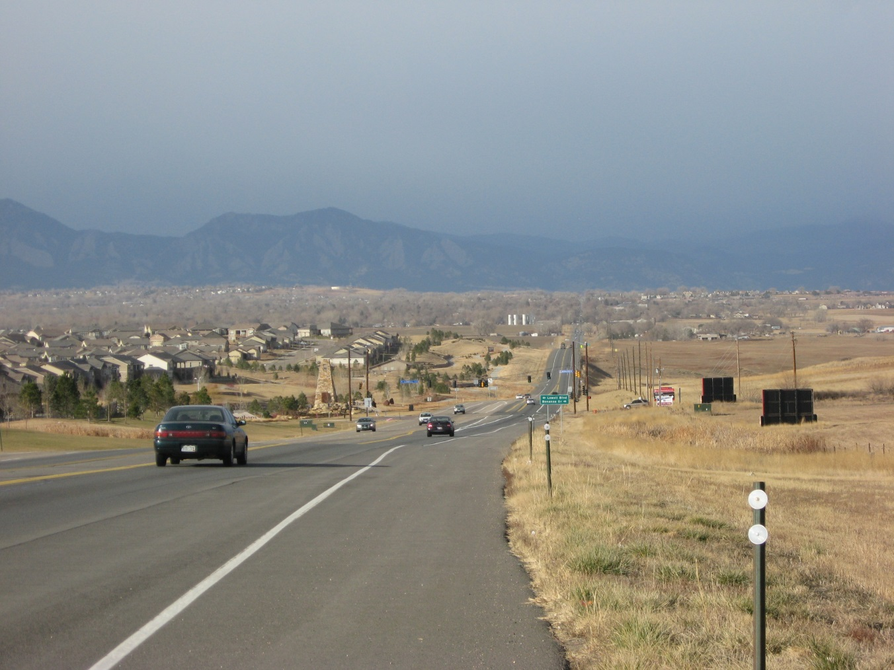
State Highway 7 Bus Rapid Transit Study

Slide 2
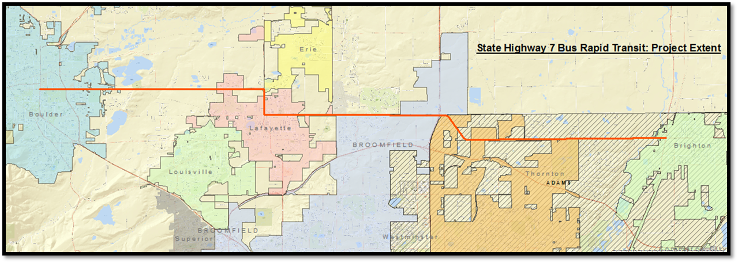
What we’re doing a nutshell…
Understanding the feasibility of implementing bus rapid transit (BRT) to provide east/west mobility options from Boulder to Brighton
Planning for multimodal transportation improvements between US 287-75th Street
Brighton
Boulder

Slide 3
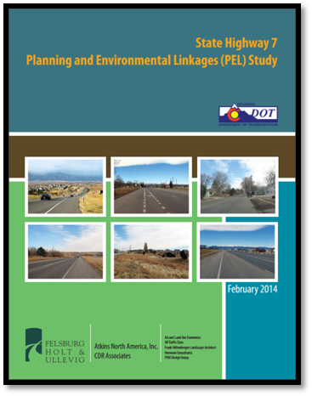
The SH 7 BRT Study Builds on Recent Efforts
Boulder
Brighton
CDOT SH 7 Planning and Environmental Linkages Study
Conducted transportation needs analysis
Identified existing and future corridor conditions
Collaboratively identified transportation enhancements

Slide 4
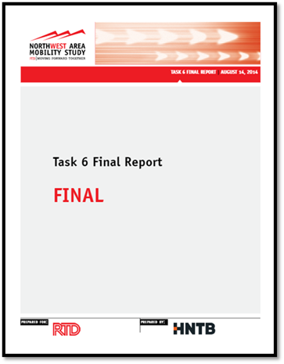
The SH 7 BRT Study Builds on Recent Efforts
Boulder
Brighton
Northwest Area Mobility Study
Preliminary evaluations of BRT feasibility on 6 regional corridors
SH 7 (Boulder to I-25) showed strongly for BRT feasibility

Slide 5
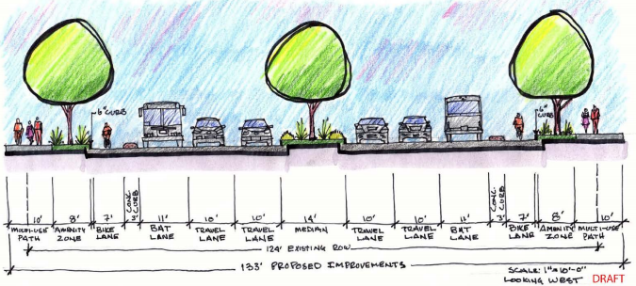
Ongoing Studies & Projects on the SH 7 Corridor
Ongoing Studies & Projects on the SH 7 Corridor
Boulder
Brighton
Envisioning future transportation improvements from Folsom to 75th Street
Evaluating impacts from alternative designs
Project supports BRT through Boulder

Slide 6
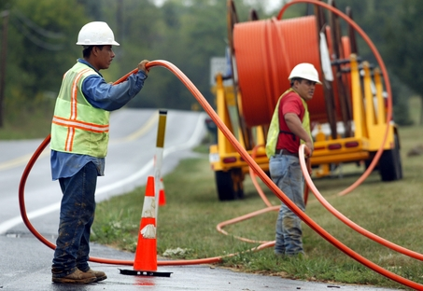
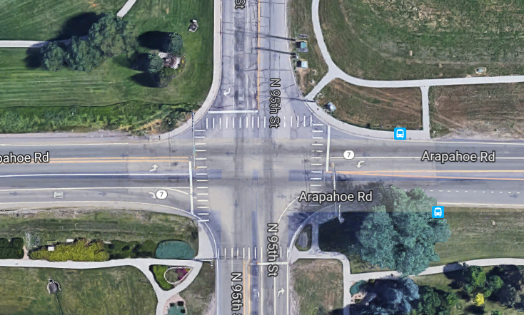
Ongoing Studies & Projects on the SH 7 Corridor
Boulder
Brighton
CDOT- SH 7 Adaptive Signals & Fiber Project (Baseline/US287 to Cherryvale Rd.)
CDOT Signal Upgrades and Fiber Installation Project (Summer 2017)
Cherryvale* to Baseline/US287
Installing fiber optic communication utilities
Upgrading signal boxes
Upgrading signal detection

Slide 7
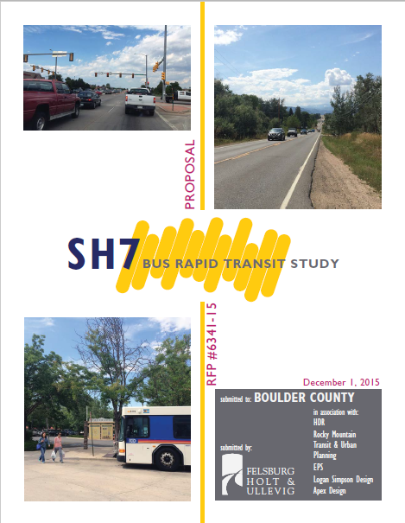
How the SH 7 BRT Study Fits in:
Boulder
Brighton
Establishes Feasibility of BRT on SH 7 from Boulder to Brighton
Provides Ridership Projections
Provides preliminary cost estimate
Planning and Environmental Linkages study for SH 7 between 75th Street and US 287
Gathers corridor conditions data
Makes recommendations for transportation improvements

Slide 8
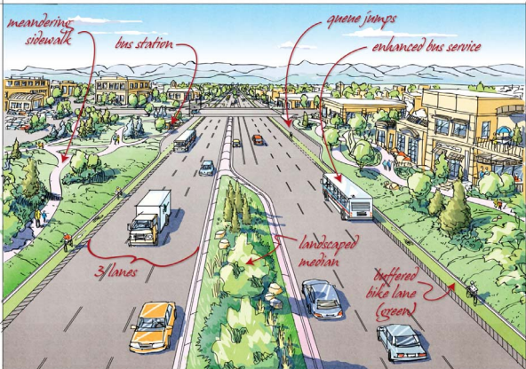
Project Goals
Safely & efficiently move people through the corridor
Source: Forth Collins Harmony Rd. ETC Master Plan

Slide 9
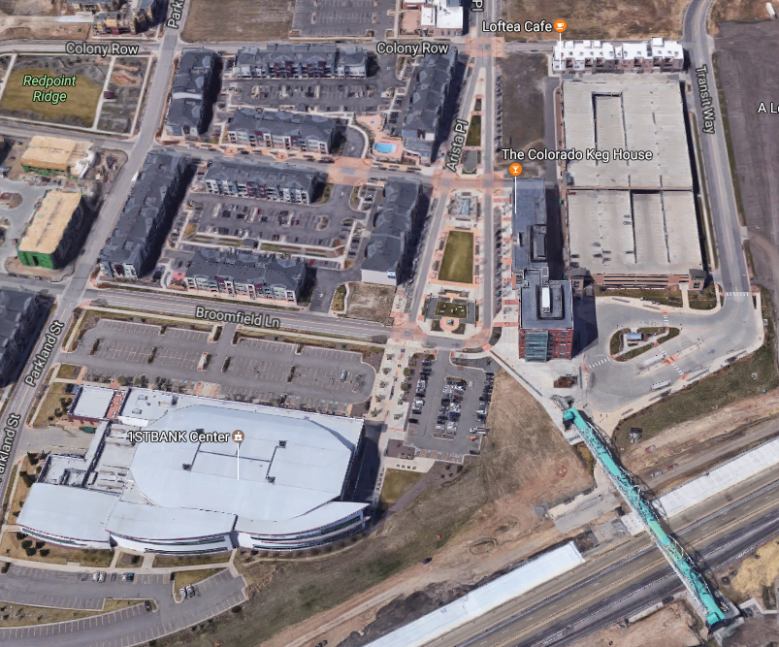
Project Goals
Promote economic vitality
Source: TOD Arista, Broomfield

Slide 10
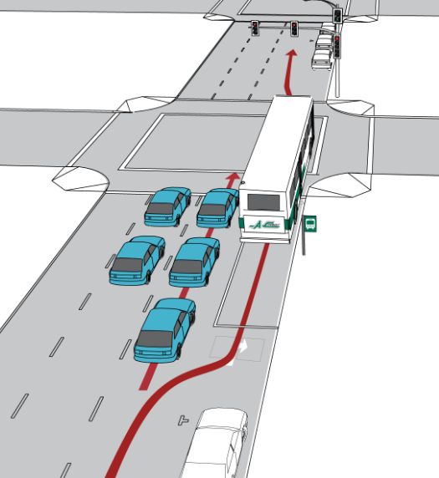
Project Goals
Identify improvements that efficiently utilize scarce financial resources
Source: AC Transit

Slide 11
Project Goals
Provide and enhance mobility options to the public (vehicles, bike, ped transit)
Source: Smartgrowth.org

Slide 12
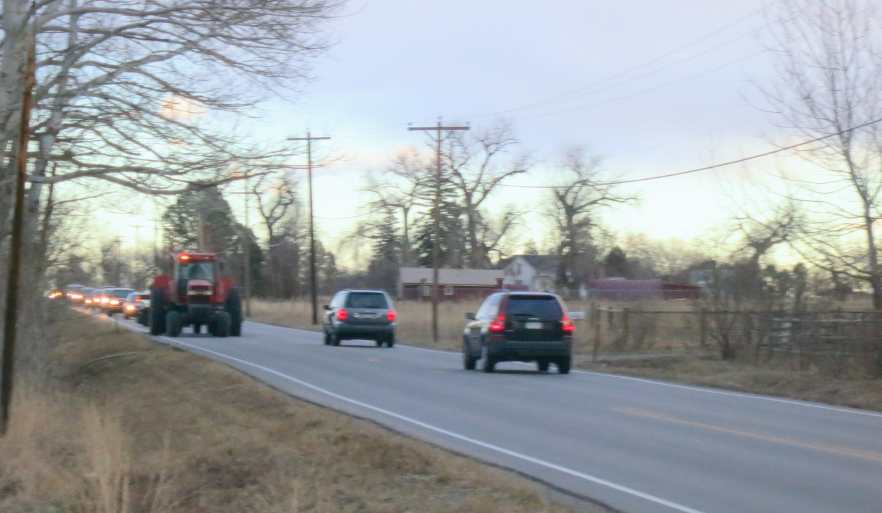
Project Goals
Maintain and preserve the rural and historic character of the corridor (US 287-75th St)

Slide 13
Collaboration: Strong project support from local governments and agencies

Slide 14
Bus Rapid Transit (BRT)

Slide 15
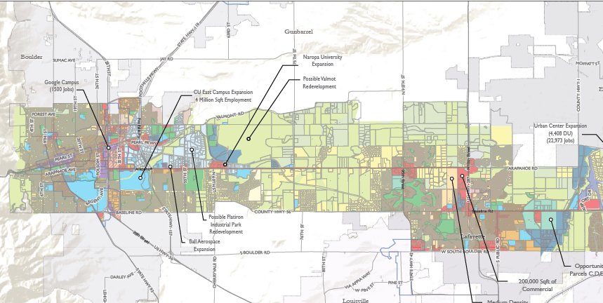
West Corridor Planned Growth by 2040
Google Campus (1500 Jobs)
CU East Expansion (4 million sq. ft.)
Naropa Expansion
Ball Aerospace Expansion
Flatiron Business Park Redevelopment
US 287/SH 7 Commercial Development( 200,000 Sq. Ft.)
Silo Housing Development (400 units)

Slide 16
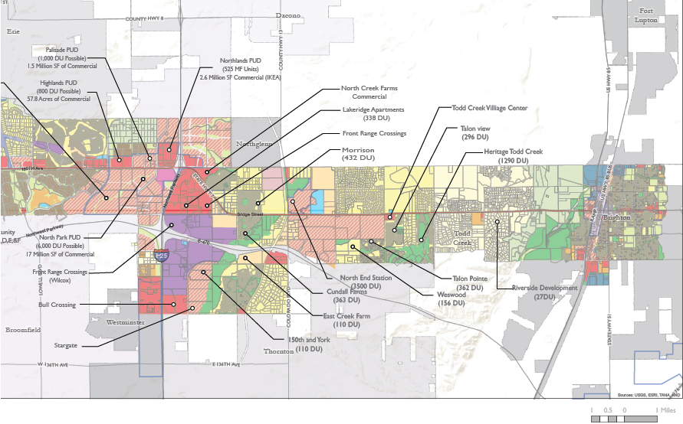
East Corridor Planned Growth by 2040
Over 23.5 million Sq. Ft. of new commercial, office and mixed use space.
An additional 23,000+ employment
Up to 19,700 new multiple and single family homes.

Slide 17
A Need for Transit
No east/west transit service east of Lafayette on SH7
SH 7 Transit would provide connections to other transit - North Metro Rail, Bustang, RX/RC, Route 120, L Route, Boulder Transit Routes
Move more people on the corridor with less need for highway expansion

Slide 18
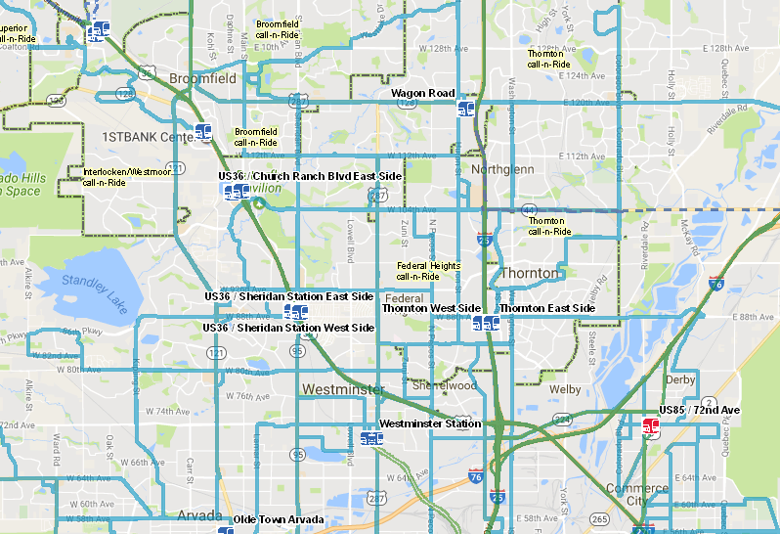
RTD Route Density in North Denver Metro Area

Slide 19
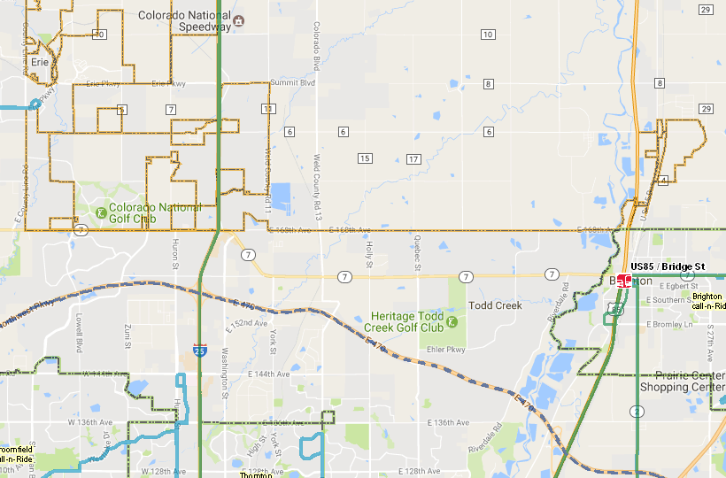
RTD Route Density around SH 7 & I-25 (same map scale)

Slide 20
Station Areas
Planning for around 10-15 total station areas for the corridor
Some station areas are determined: I-25, Boulder Transit Center, etc.
Others will depend on transit routing and will be determined in the Station Area Design Study

Slide 21
2040 Ridership Modeling Results & Corridor Travel Times
Mixed Traffic with Transit Signal Priority and Queue Jumps
6,100 - 6,500 Boardings per Day
Peak Hour Travel Times: 76-77 minutes end-to-end
Free Flow (Bus on Shoulder or Exclusive lane)
8,600 – 8,700 Boardings per Day
Peak Hour Travel Times: 54 minutes
Future Projected Automobile Travel Time on the Corridor End-to-End
84 minutes

Slide 22
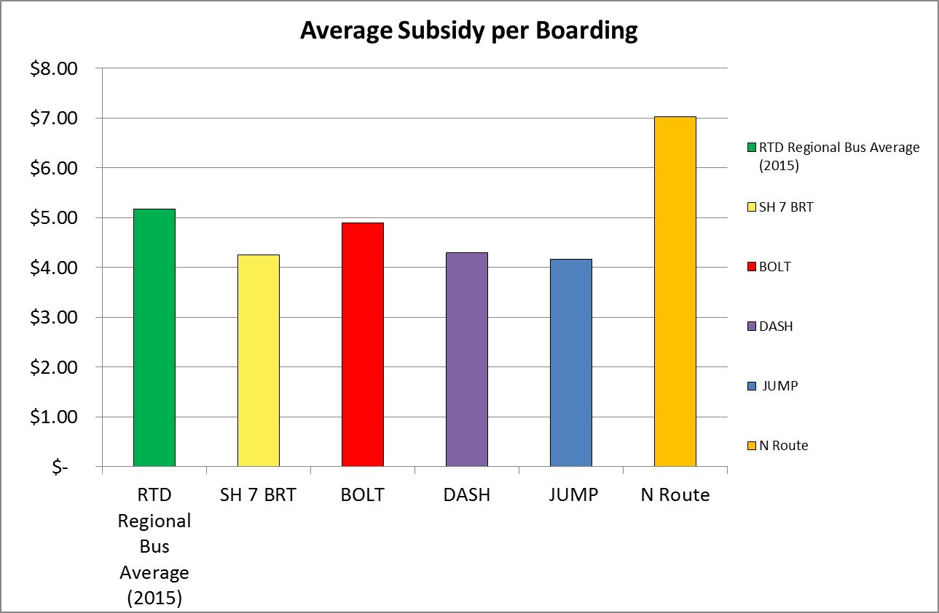
Costs
SH 7 BRT Boarding Subsidy: $4.26

Slide 23
Planning and Environmental Linkages (PEL) Study
75th Street to US 287

Slide 24
Our Purpose and Need Statement
“The purpose of the proposed multimodal transportation improvements is to address safety for all users and move people efficiently through the corridor.”
75th Street to US 287

Slide 25
Rural Character

Slide 26
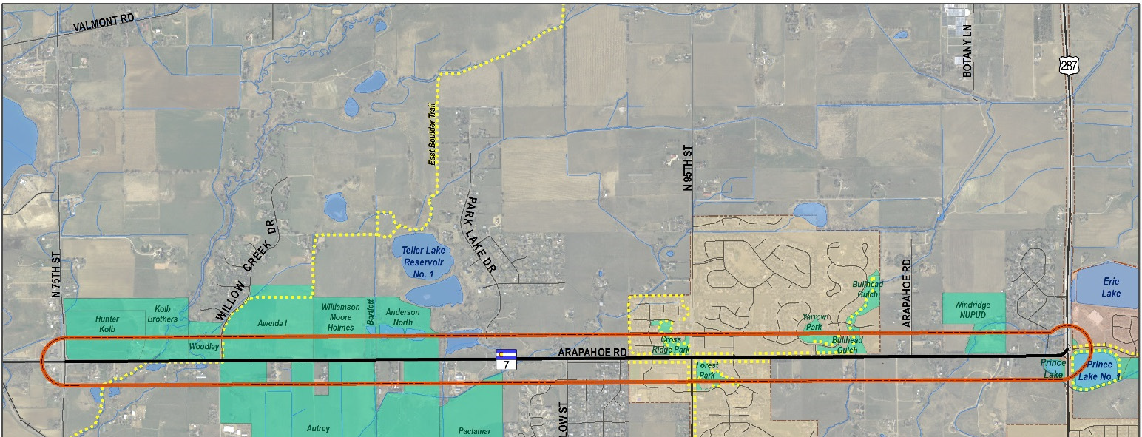
Lower potential for land use change on this stretch of corridor
Little or no growth between 75th Street & Dagny Way
Some moderate growth between Dagny Way and US 287

Slide 27
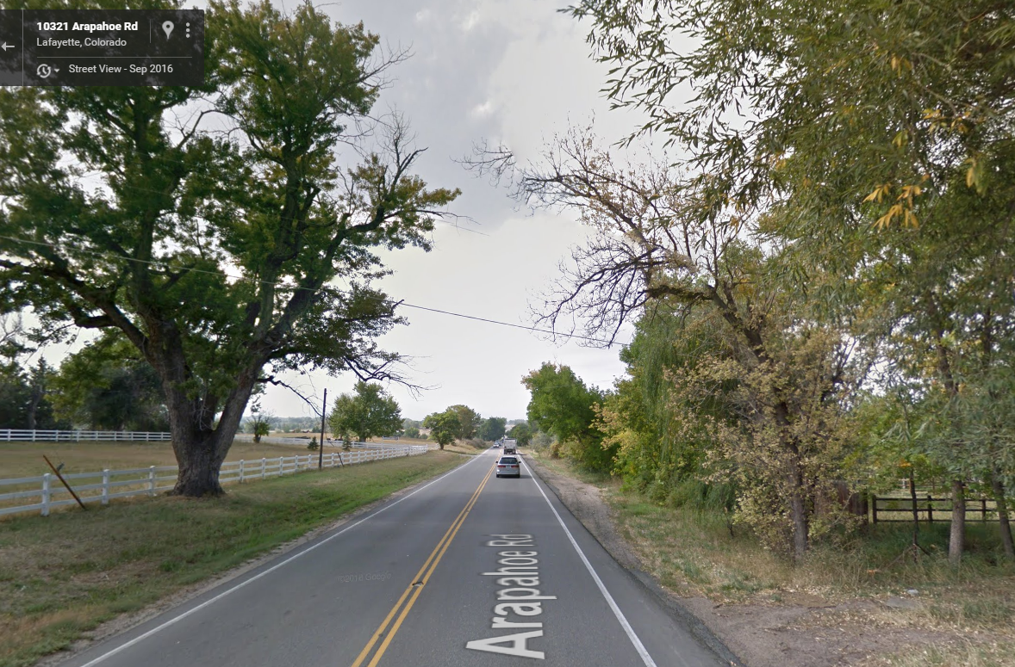
It’s a PRIMARY goal to maintain the rural character

Slide 28
It’s a PRIMARY goal to maintain the rural character

Slide 29
It’s a PRIMARY goal to maintain the rural character
2’
12’
12’
2’

Slide 30
It’s a PRIMARY goal to maintain the rural character
4’
12’
12’
12’
12’
4’

Slide 31
It’s a PRIMARY goal to maintain the rural character
CLEAR ZONE .
CLEAR ZONE
4’
12’
12’
12’
12’
4’

Slide 32
Existing and Future Traffic

Slide 33
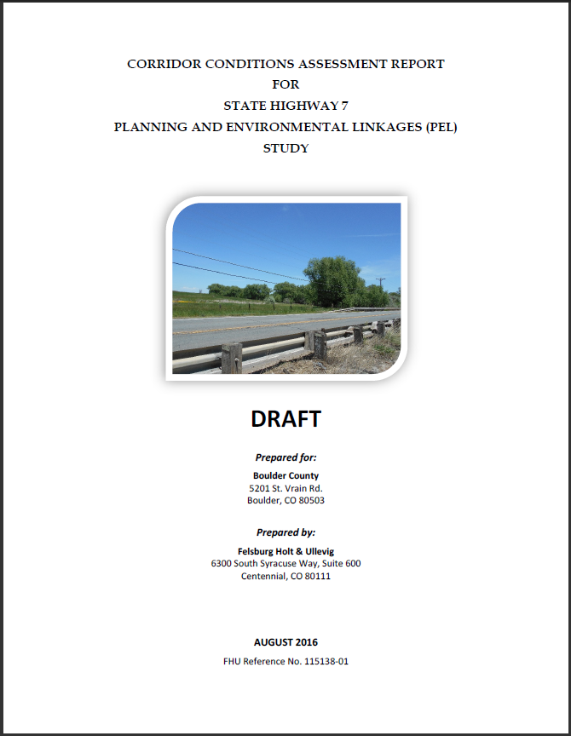
SH 7 Traffic Volumes
(Vehicles per Day)

Slide 34
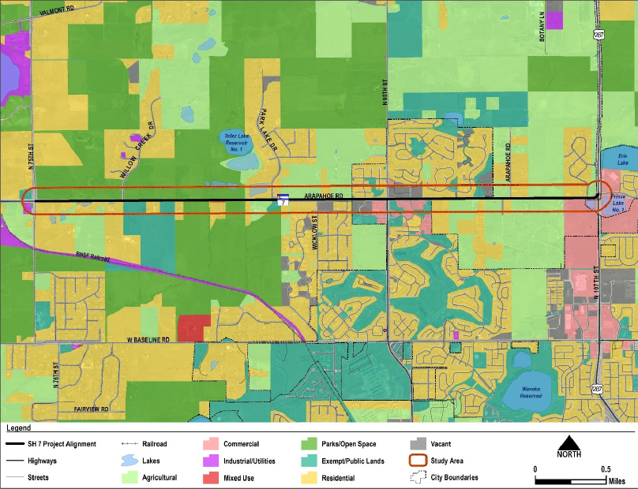
Existing Land Uses

Slide 35
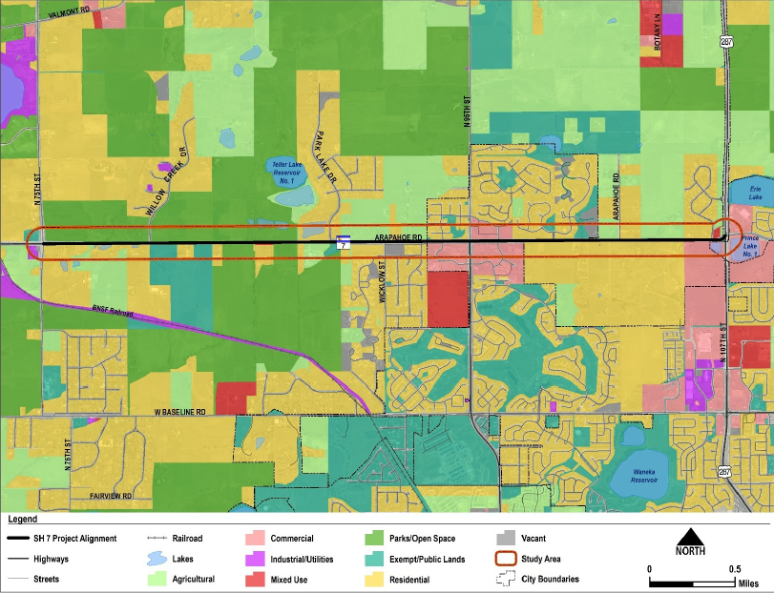
Future Land Uses

Slide 36
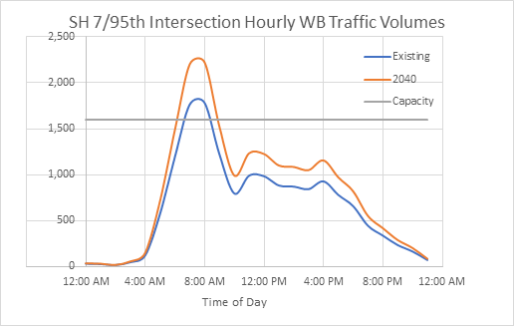

Slide 37
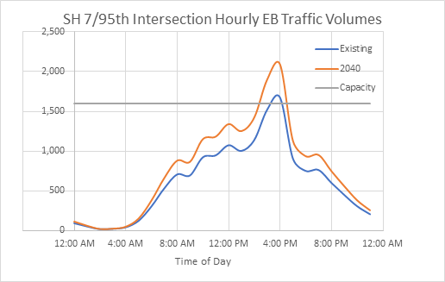

Slide 38
Traffic Probe Run: 7:00 AM Westbound
Red < 15 MPH, Yellow 15-30 MPH, Green 30-50 MPH, Blue > 50 MPH

Slide 39
Traffic Probe Run: 4:20 PM Eastbound
Red < 15 MPH, Yellow 15-30 MPH, Green 30-50 MPH, Blue > 50 MPH

Slide 40
Focus on improving intersections over adding more lanes to improve corridor efficiency and safety
One lane:
1,800 vehicles/ hour

Slide 41
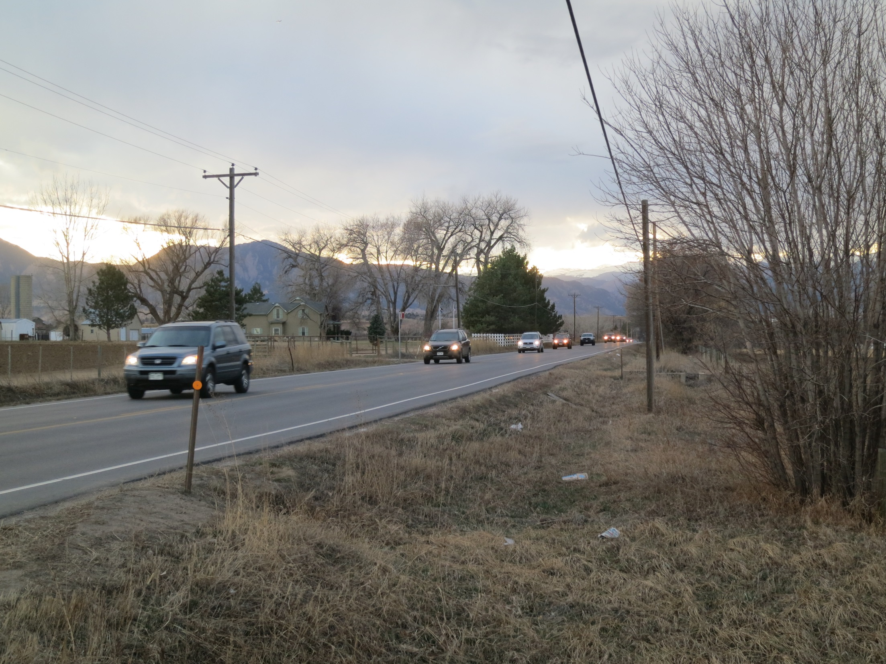

Slide 42
One lane:
900 vehicles/ hour
STOP
Half the time is green Half the time is red

Slide 43
Two lanes @ 900 veh/hour
= 1,800 vehicles/hour
STOP

Slide 44
900 veh/hour
x 2
1,800 veh/hour
1,800 veh/hour

Slide 45
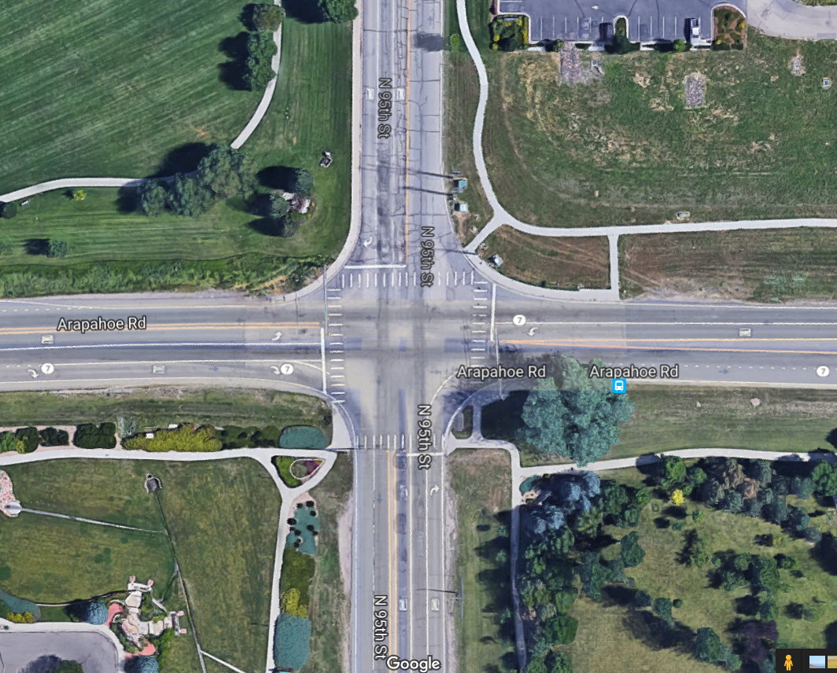

Slide 46
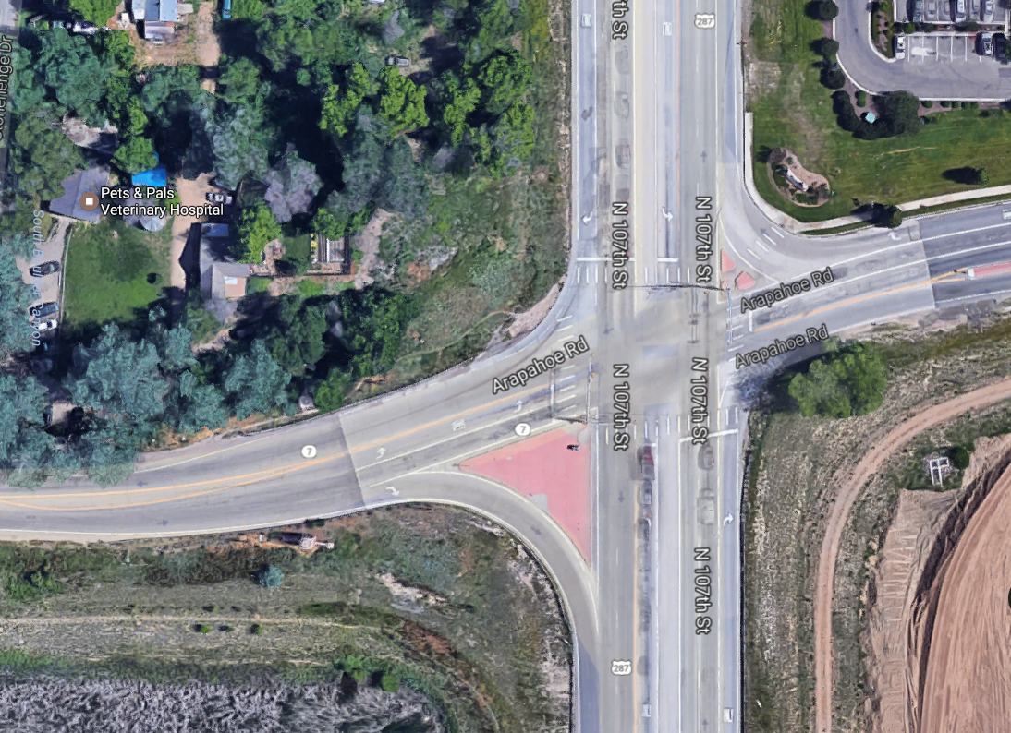

Slide 47
Multimodal Corridor

Slide 48
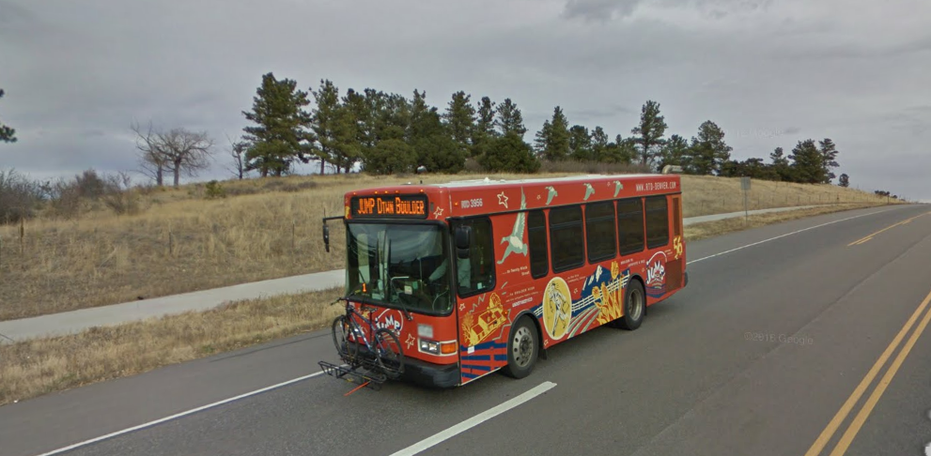
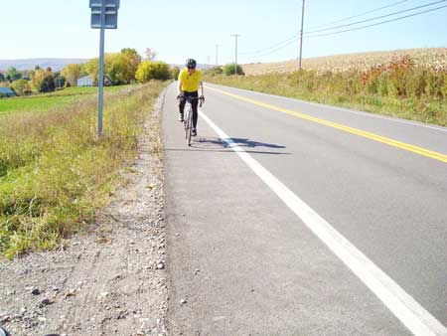
Potential Bicycle Improvements
Typical Arterial Shoulders
Separated Multiuse Path
Source: Cornell Local Roads Program

Slide 49
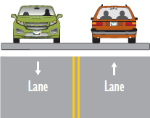
We could improve this for bikes by adding shoulders
Existing lane configuration on SH 7
We could also add sidewalks in more urban areas (95th St.) and around bus stops

Slide 50
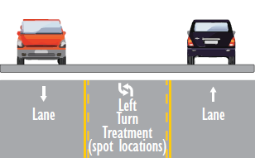
We would also consider adding center turn lanes in locations with more frequent left turning movements
Left Only

Slide 51
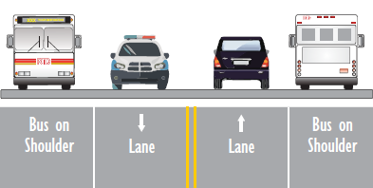
Or we could add a wider shoulder that could be used as a Bus Only Lane or Managed Lane
We could improve this for bikes by adding just shoulders and adding sidewalks in spot locations
What we have today
If we consider this option, we would have to include separated multiuse path

Slide 52
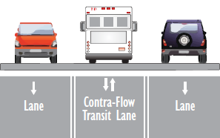
Given peak directions - possible contraflow lane
Vehicle-to-vehicle communication
Infrastructure-to-vehicle communication
Autonomous vehicles
Other emerging technologies

Slide 53
Next Steps:
Hold a final public meeting to review the draft study and collect final public input about transportation improvements from 75th St. to US 287 (Early Summer 2017)
CDOT traffic signal enhancements (Summer 2017)
Initiate SH 7 Station Area Design Study (Summer-Fall 2017)
Finish the East Arapahoe Plan (Winter 2017)
Apply for funding to complete a comprehensive SH 7 BRT Plan (2018-2020)
Pursue opportunities (funding/working with developers) to make incremental transportation system improvements corridor wide

Slide 54
What we are looking for with your feedback:
Bus Rapid Transit – Please share your thoughts about future BRT on the corridor
Purpose and Need Statement
Do we have it about right?
Are there changes that should be made?
“The purpose of the proposed multimodal transportation improvements is to address safety for all users and move people efficiently through the corridor.”
Alternative Cross Sections
Is our focus on intersections the right approach?
How important is maintaining the rural character of the corridor?
What are your reaction to the alternative cross section options?
What type of bike facility would you like to see?

