Slide 1
Boulder County Consumption-Based Emissions Inventory
By Tim Broderick: Senior Sustainability Strategist, OSCAR

Slide 2
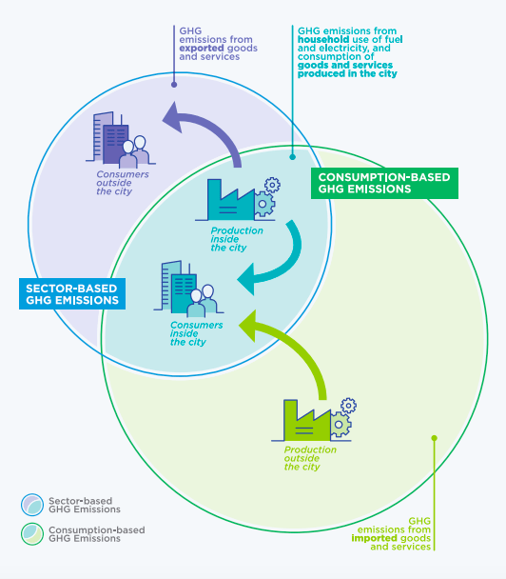
What is a Consumption-Based Emissions Inventory?
A consumption-based emissions inventory (CBEI) calculates the greenhouse gas (GHG) emissions associated with producing, transporting, using, and disposing of products and services consumed by a particular community in a given year. (USDN Sustainable Consumption Toolkit)
Source: C40 Cities

Slide 3
Why CBEIs Matter
“There are only a handful of Consumption-based Inventories. Their results, however, are striking because they highlight the large percentage of GHGs that are not being measured and tracked. Given the oft-quoted maxim, “what gets measured gets managed,” the failure to track GHGs associated with the local consumption of goods, food, and services has dire implications for what is measured and managed. Failure to measure consumption-based GHGs provides incomplete data to local governments and citizens. Without the complete data, meaningful and targeted climate mitigation regulation is extraordinarily difficult.”- Jonathan Rosenbloom, University of Colorado Law Review; Outsourced Emissions: Why Local Governments Should Track and Measure Consumption-Based Greenhouse Gases March 18, 2021

Slide 4
Consumption-Based Emissions Inventory Overview
5 household consumption categories:
Transportation, housing, food, goods, & services of residents
Driven by 6 key characteristics:
Average household characteristics
Includes incorporated + unincorporated communities
Income
Household size
Home size (# rooms)
Home ownership
Vehicle ownership
Educational attainment

Slide 5
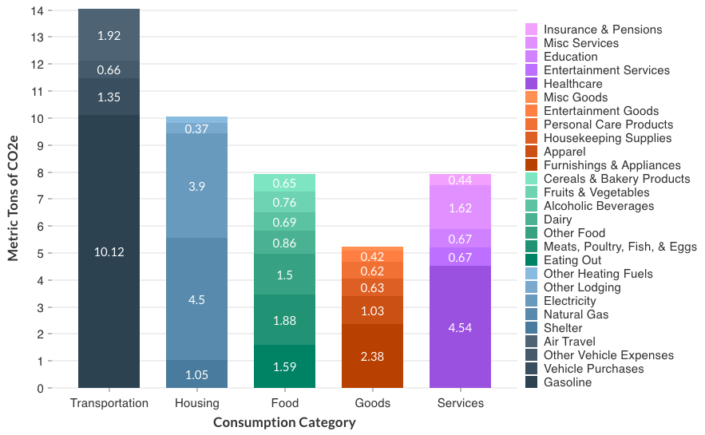
Consumption-Based Inventory
2021 CBEI:
45 MTCO₂e per HH
19 MTCO₂e per person
6 million MTCO₂e countywide
Consumption-based approach: +43%
2021 GHG Inventory:
13 MTCO₂e per person
4.2 million MTCO₂e countywide
Notes:
Almost eclipse the global median HH by a factor of five. Canada and Australia is around 20 tons. Germany, Norway, and the Netherlands is around 15 tons. France is down to 9 tons. So where do we need to be? 2 tons per capita to limit the world to 1.5 degrees Celsius of warming.
Among all categories, transportation, housing, and services are the largest overall categories, accounting for 31%, 23% and 17% of emissions, respectively. Together these account for 70% of total emissions. Within subcategories, gasoline, healthcare, and natural gas are the top three, accounting for 22%, 10%, and 10% of total emissions respectively a combined 42%.

Slide 6
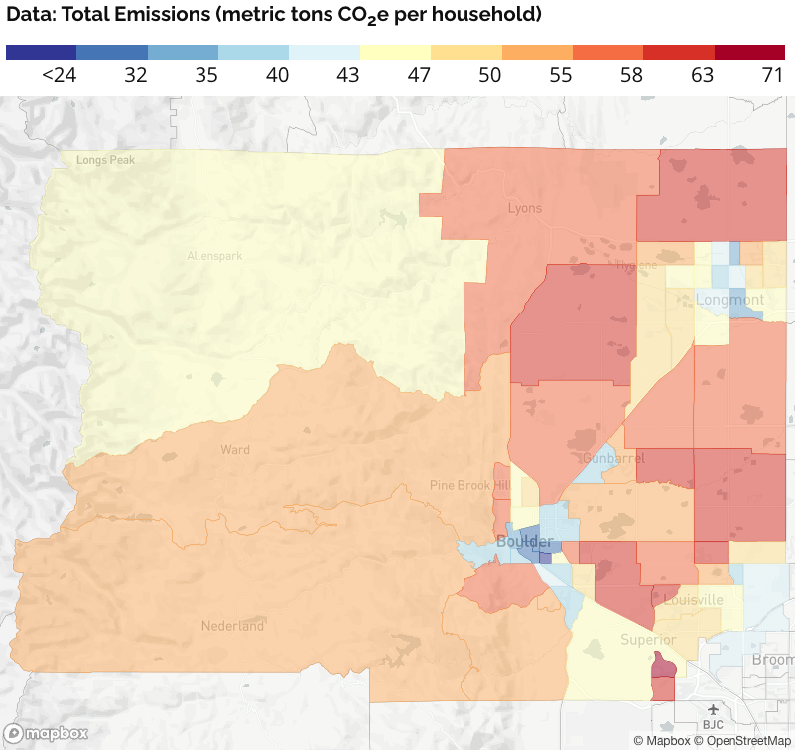
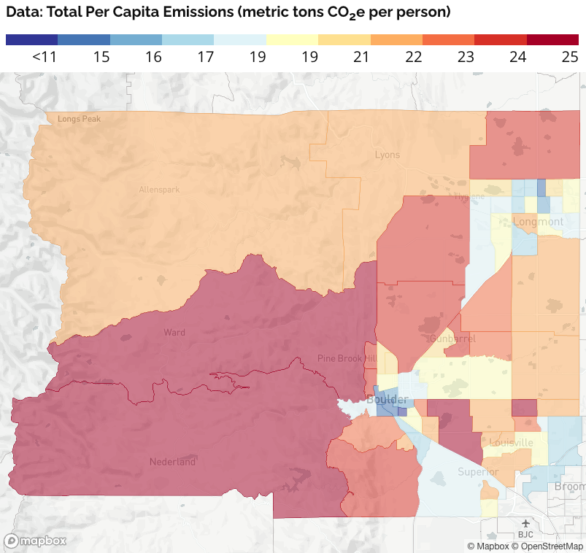
Consumption-Based Inventory

Slide 7
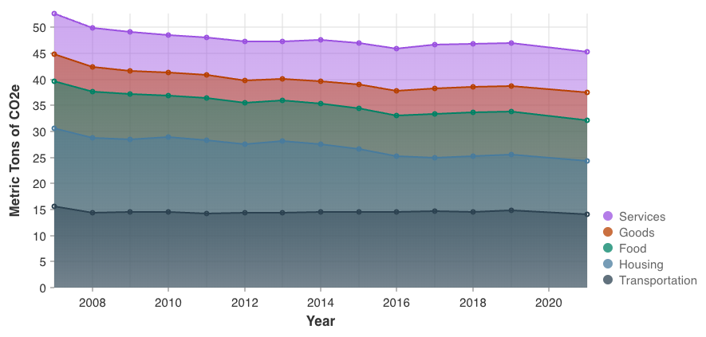
CBEI: Key Takeaways
High energy emissions have declined significantly due to cleaner power, but still a long ways to go.
Highly auto-dependent, large home sizes
Transportation & buildings largest categories – aligned with geographic inventory. Food & Services are almost as large as residential energy usage
Mostly minor changes in household characteristics since 2007

Slide 8
Transportation
Collaboration with existing efforts
Deepen regional goals between electrification of transportation, reduction in vehicle ownership, building densification, affordable housing, and public health impacts.
Consider support for the development of sustainable aviation fuel production locally within the county (?)

Slide 9
Housing
Support existing electrification programs
Building ordinances that require the use of recyclable, recycled content, or carbon reduced building materials. Ordinances need to align with county or regional inputs such as recycled concrete.
Lean on existing efforts to densify and create smaller living footprints along public transportation pathways.
Deconstruction ordinances to divert materials from the landfill and decrease incoming building materials supply chains.
C&D sortation infrastructure to support a more closed loop supply chain for building materials.

Slide 10
Food
Elimination of the use of synthetic fertilizers on all public lands and private. This means alternatives such as compost and livestock nitrogen must be supported as supply chain alternatives.
Red meat tax, has impacts on both climate and public health. Tax would go directly towards supporting regenerative agriculture. Systems level change is build into the pricing structure the negative externalities of goods consumed.
Food waste diversion policy, tier 1 edible foot waste to food banks. Tier 2 compost which would increase availability of high quality compost and ties with the recent change of A1 organics policy of food waste only diversion.

Slide 11
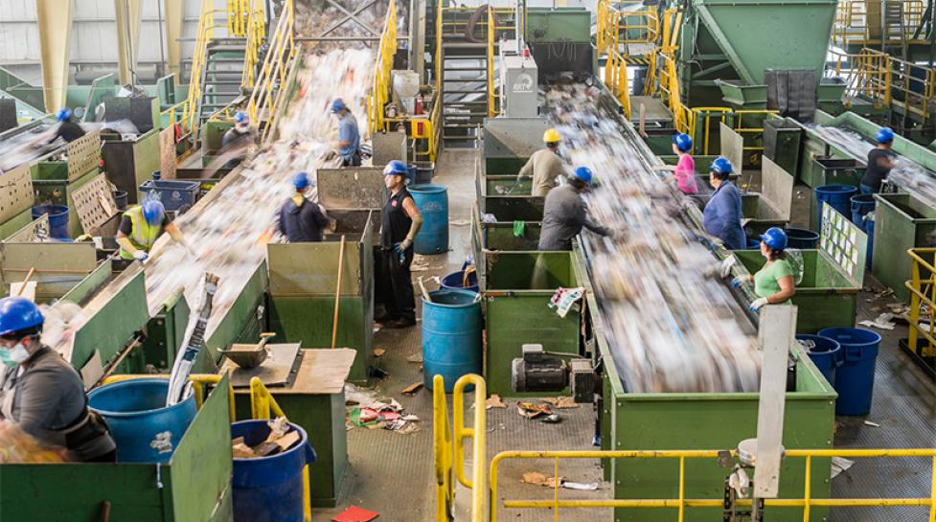
Goods
EPR extension to all categories of consumed goods starting with furniture and household appliances (durable goods). Systems level change is build into the pricing structure the negative externalities of goods consumed.
Support building code and land use development to support dense / small footprint housing.
Develop a program to work with existing manufacturers (10% of the states manufacturing) to decrease scope 3 emissions.

Slide 12
Services
Accelerate the work of green businuess programs across the county with data sets on industry specific consumption impacts.
Collaborate with existing programs to engage healthcare services specifically to decrease their carbon footprint.
Systems level change is build into the pricing structure the negative externalities of services consumed.

Slide 13
Discussion / Q&A

