Slide 1
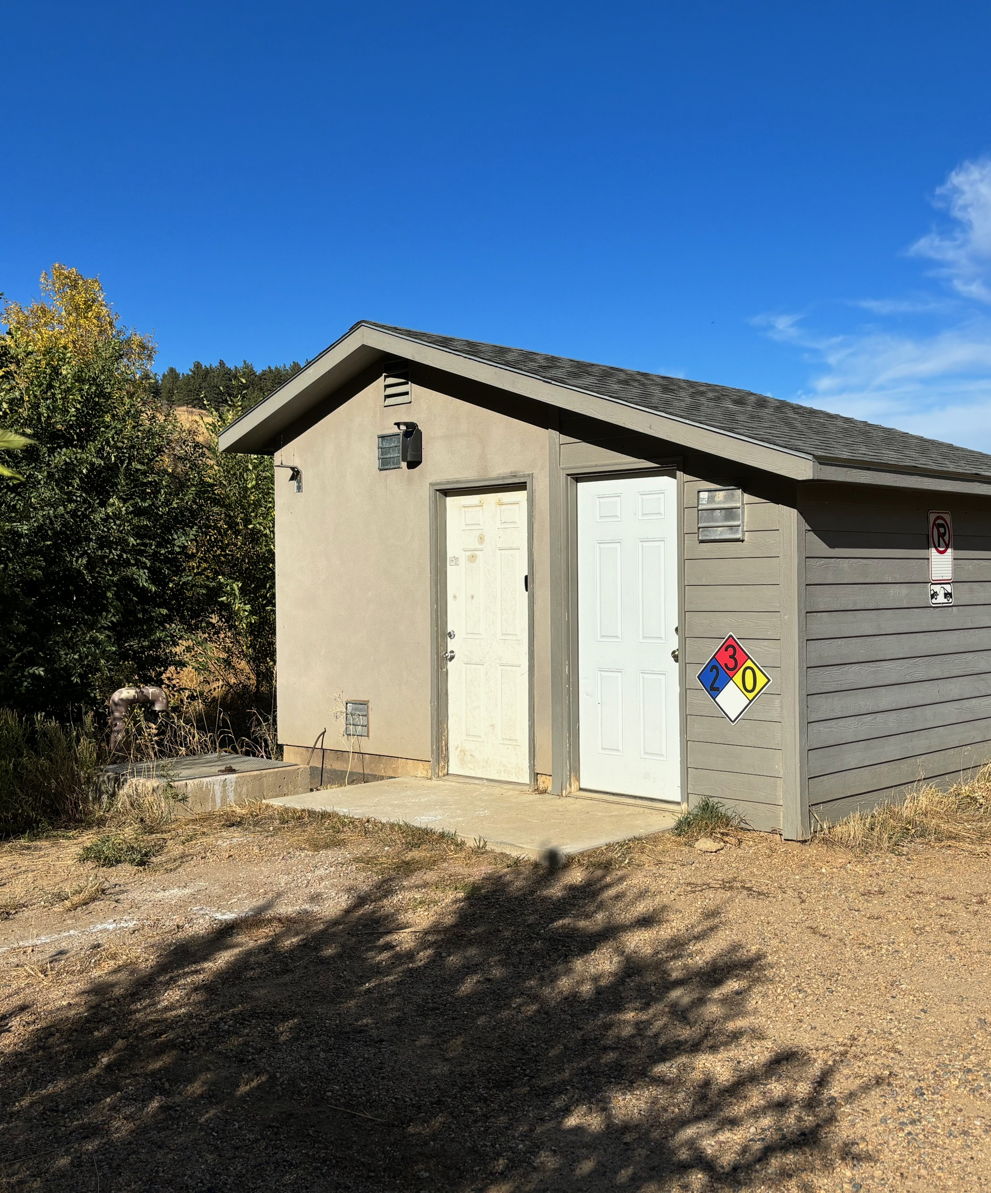
Eldorado springs wastewater treatment facility
funding scenarios
FEBRUARY 8, 2024

Slide 2
Current scenario
Local improvement district finances
Created in 2008 TO FUND ORIGINAL TREATMENT FACILITY AND COLLECTION SYSTEM
BY LAW, LOCAL IMPROVEMENT District MUST dissolve once debt is paid off (December 2025)
LID MECHANISM CANNOT BE USED for ongoing operations
CURRENT revenues come from three sources:
Fees collected for operation costs (EQR)
Property assessments for loan payoff
Plant investment fees collected at building permit

Slide 3
Current scenario
Local improvement district – fees (EQRs)
Annual Operating budget - $96,310; does not cover capital needs; actual expenses have been over $130,000 each year
Equivalency rates (EQRs) vary by property and property type
Commercial vs. residential
Number of bathrooms in home and buildings
Each property pays $153.16 per eqr – 93 properties with 153.50 EQRs total
Total collected annually for 153.5 EQRs is $94,040
Not sufficient to sustain operation of district

Slide 4
Current scenario
Local improvement district – property assessments
Original debt of $2,000,000
Annual debt payment is $112,000, collected through property assessments
Debt retires in December 2025
Once debt retires, property assessments end

Slide 5
Current scenario
Local improvement district – plant investment fees
Plant investment fee collected for building permits on each property; adds to the fund balance
Large capital purchases and operating expenses come from decreasing fund balance currently at ~$217,000 (rules limit what can be purchased)

Slide 6
Future conditions
Local improvement district – future revenues
Need to evaluate fees, up-to-date operating costs, and future needs through Assessment study
evaluation of existing plant condition and future needs
review ongoing operations and potential improved efficiencies
Audit eqrs on each property to ensure they are accurate

Slide 7
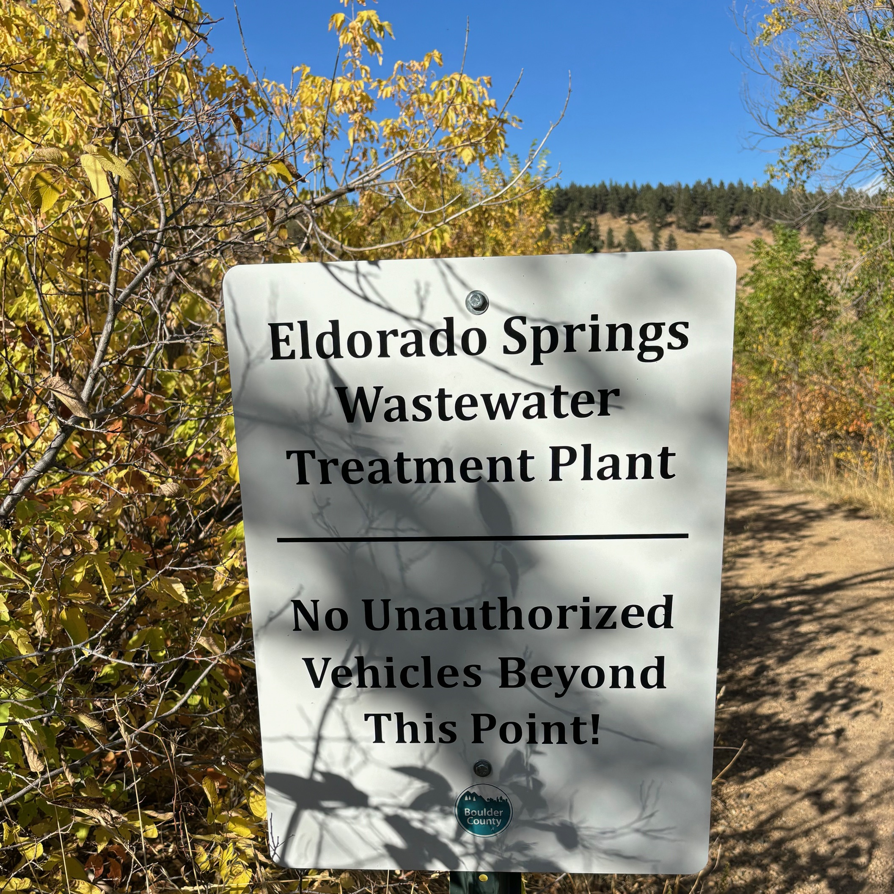
possible scenarios
Public improvement district
Title 32 Special District
Other options
County run
Privately run
Incorporation/muni run
Notes:
Hello everyone I’m Olivia Lucas, senior assistant county attorney who works with the county’s special districts. I’m here to discuss what we see as the legal options for operating this system going forward.
As Mike mentioned, the LID is not a viable legal entity to operate the plant. So we need to find a new one. I’ve been working with Mike and Taylor and Jenn to think through possible legal scenarios for plant operation and future maintenance/capital improvements.
The goal is to put in place a long-term legal structure for the plant’s operation and maintenance. Ideally this would be something that includes community involvement and is a sustainable funding model. This meeting is to give you information about potential options so you can begin thinking about them. Several require community action to move forward. The last loan payment will be made in Dec. 2025, so it woud be best to put any required ballot issues on the November 2024 ballot to give time for an election and to stand up that structure. We’ll talk through the opetions and compare some of their features today and then be ready for questions today. As we’ll discuss, this isNOT your only opportunity to provide feedback.

Slide 8
Public improvement district
Public improvement district (C.R.S. 30-20-501 et seq.)
Would operate Similar to current system
PID can obtain loans, grants, issue bonds for capital improvements (lid cannot); charge rates and fees for operations
Term not dependent on length of any payback period; Can last as long as needed
Established by petition to BOCC of 30% of electors seeking formation, and general election to establish the district and any funding
To be ready for December 2025, best if PID is on ballot in November 2024 election
Notes:
The community could decide to request that the BOCC approve a public improvement district. This is substantially similar to a LID, in that it has similar funding mechanisms for operations and can issue bonds for capital improvements. If another large capital improvement is required, a PID can even establish a LID.
The main difference is that by statute, a PID is longer-term – its existence doesn’t depend on the term of the loan. This structure is closest to the status quo.
It does take some community involvement to establish. By statute, the community must sign a petition seeking to establish the PID and that petition is provided to the BOCC. They hold a public hearing to discuss, and then put the formation on the ballot for a vote.
The structure of the PID would be similar – the BOCC is the PID board, and it’s very likely the Board would continue to seek input from the ESLIDAC or a similar body.

Slide 9
Title 32 special district
title 32 special district (C.R.S. 32-1-101 et seq.)
Could form a Sanitation district or a metropolitan district
Metropolitan district must include two or more functions (e.g. sanitation and mosquito control or street improvement – see CRS 21-1-103(10))
Formation steps: Proponents present petition to BOCC, BOCC reviews service plan and approves, court order for election to form district, and election to form, finance and elect board
Operations directly managed by district representatives – county not involved
Notes:
Alternatively, if the community wanted to take full control of all aspects of the WWTP and service, members could try to form a Title 32 special district. These are quasi-municipal bodies that exist to provide services. Under Title 32, it appears that the community could form a sanitation district or a broader metropolitan district which would include both sanitation services and at least one other service as listed in the statute – e.g. mosquito control, street improvement, etc.
Formation is a bit more complicated than a pID. For a special district, any number of people act together to put together a service plan. They submit the service plan to the BOCC, which holds a hearing on the plan. If the BOCC approves the service plan, then the proponents go to court to seek an order to put the special district on the ballot. Folks vote, and if it’s approved, it’s its own entity that takes over all the operations of the system.

Slide 10
Other options
County run – per statute
Need input from BOCC on whether advisory committee available if county run
Sale to private entity (Some regulation by public utilities commission)
Eldorado springs pursue incorporation to operate system as a municipality
Notes:
The other options we have put out for your consideration are that the system could be simply run by the county, without a special district. The county has statutory authority to provide this service and charge fees, etc., for it. We would need to get input from the BOCC about whether they’d still seek an advisory committee, as the actions they take would be as the BOCC, not a board of a special district.
We have heard that people may be interested in a slae to a private entity. The BOCC has expressed to us that they are concerned about rate hikes with a privatization plan, but the PUC does regulate small water systems. We are not aware of any interested buyer.
Finally, another potential option is that the community itself run the plant in some way. Statutes provide that municipalities can run their own sewer systems. Eldorado Springs would need to either incorporate ro try to annex into another existing municipality to get that statutory authority. We have looked a little bit into this and it appears that annexation may not be legally feasible based on Eldorado spring’s location. We are not sure about incorporation, but it may be possible depending on the number of electors in the community.

Slide 11
TABLE of options and issues
 | Public Improvement District | Title 32 Special District | County run | Privately run | Eldorado Springs run (town incorporates)
County involvement in WWTP operation | Yes – BOCC is board of PID | No | Yes | No | No
Resident Involvement in WWTP operation | Likely that Advisory Committee structure would continue | Yes, to the extent that residents form the special district | Possible. Residents would need to engage BOCC regarding whether ESLIDAC would continue | No | Yes – Run by municipal gov’t
Resident involvement in formation of entity operating WWTP | Yes – Residents petition BOCC for creation of district and may be involved in setting question for election | Yes – residents propose special district, design service plan, present to BOCC and if BOCC approves service plan, proponents are involved in setting questions for election | No (other than county outreach on the subject) | No | Yes – need to take steps to incorporate (if legally feasible)
Notes:
Now I’ll go over some of the bigger issues we looked at to discuss how the various scenarios compare. There are hard copies of this table as well.

Slide 12
 | Public Improvement District | Title 32 Special District | County run | Privately run | Eldorado Springs run (town incorporates)
Estimated timeline for formation of legal entity operating WWTP | Q1 2024 - outreach June: BOCC action on petition July: Notify County Clerk of intent to participate in Nov election August: public hearing to finalize ballot language September: deadline for BOCC to adopt ballot certification resolution October: deadline for BOCC to withdraw ballot measure; ballots mailed to voters November: election | Q1 2024 outreach May or June: proponents present service plan to BOCC; hearing is held If service plan accepted, proponents seek court order to hold election July: Notify County Clerk of intent to participate in Nov election August: public hearing to finalize ballot language September: deadline for BOCC to adopt ballot certification resolution October: ballots mailed to voters November: election | Upon county resolution – timing somewhat less restrictive than specific deadlines | Potentially up to a year to market and sell | At least a year for incorporation to occur, then potentially more time for control to transition from county to new municipality

Slide 13
 | Public Improvement District | Title 32 Special District | County run | Privately run | Eldorado Springs run (town incorporates)
Separate Vote required for formation of entity operating WWTP | Yes | Yes | No | N/A | Yes – vote needed to incorporate
Separate Vote required for assessments taxes associated with operation and/or maintenance of WWTP | Yes | Yes | N/A because no taxing authority related to operations | No – no taxing authority | N/A because no taxing authority related to operations
Permitted methods for raising capital for improvements to WWTP | Ad valorem tax, bonds, loans; may create LID | Ad valorem or sales/use taxation, bonds, loans | Bonds or loans – no taxing authority; may create LID | Private capital | Bonds or loans – no taxing authority
Method of paying for operation of system | Fees, rates, tolls or charges | Fees, rates, tolls or charges | Fees, rates, tolls or charges | Fees, rates, tolls or charges | Fees, rates, tolls or charges

Slide 14
Next steps
Commissioners’ town hall meeting – March 14, 5:30-7
Follow up meeting regarding WWTP district – April
Advisory committee meetings third Thursday of each month; public invited
If pid – need petition for district creation by early may for public hearing and BOCC action in June for November 2024 election
If title 32 district – need service plan to BOCC by early may for public hearing and BOCC action in June for November 2024 election
by may for approval hearing and court action for election by June for November 2024 election

Slide 15
Questions?

Slide 16
For more information
Contact:
Taylor Ladenburg
303-441-4873
Tladenburg@bouldercounty.gov

